Slide 1
A Little Can Go A Long Way
Classification, Prediction, and Ethical AI Strategy
Applications in Game Theory
Ritwik Awasthi

Slide 2
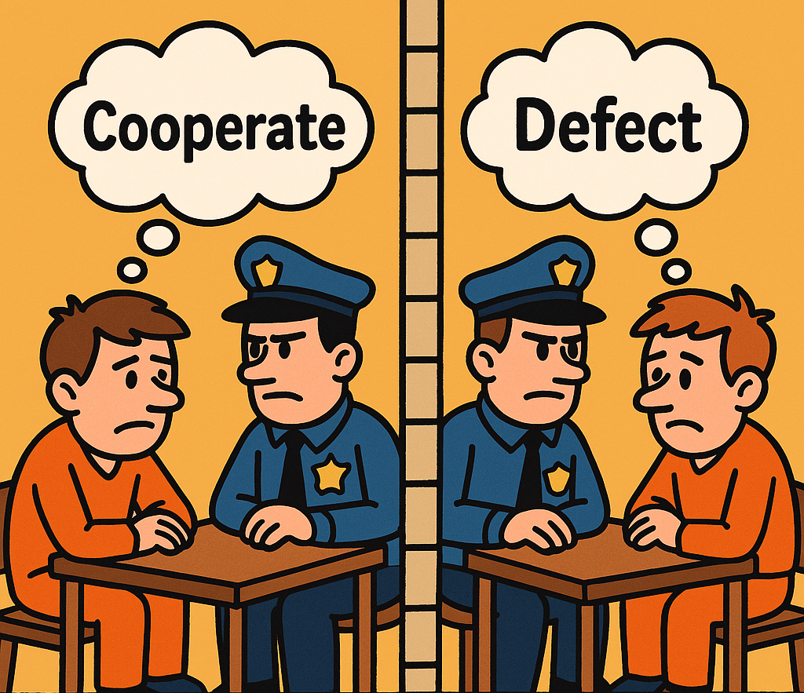
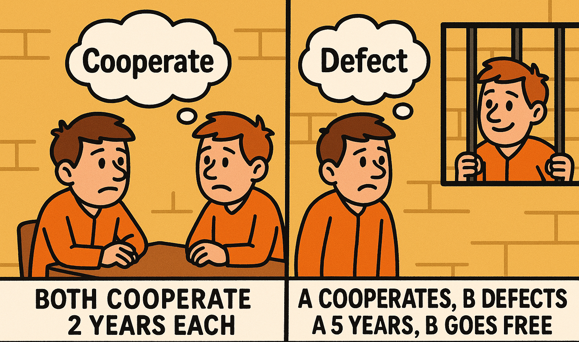
Prisoner’s Dilemma
Two isolated suspects must each choose to either cooperate or defect:
If both cooperate, they each receive a light sentence
If one defects while the other cooperates, the defector goes free and the cooperator receives a harsh sentence
If both defect, they both receive a moderate sentence.

Slide 3
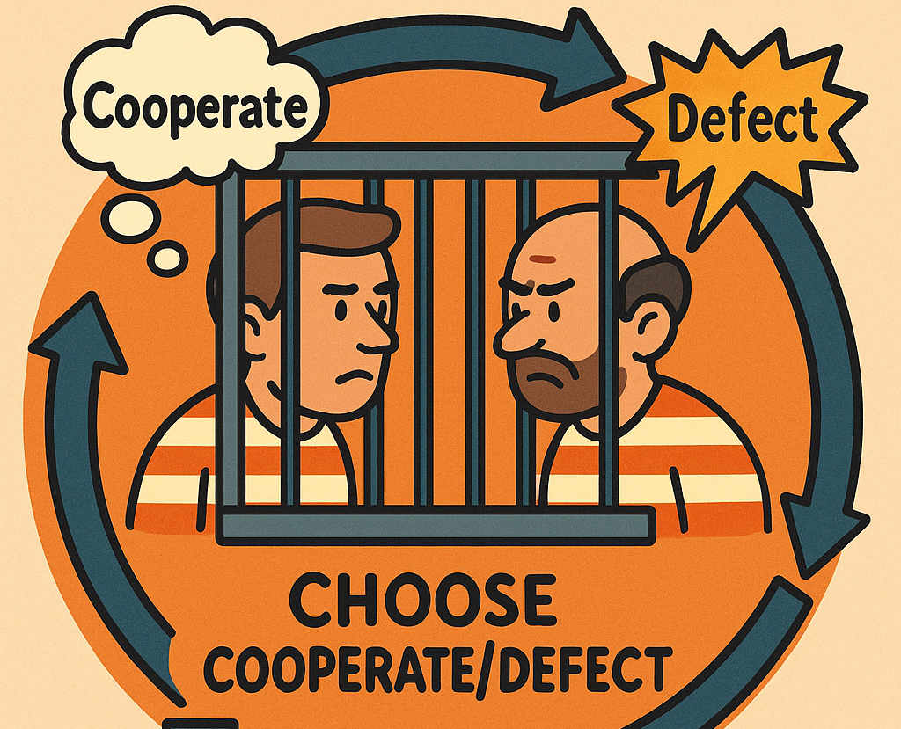
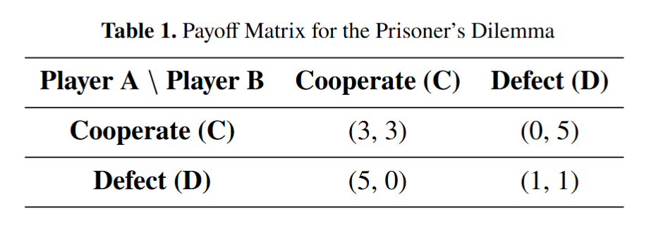
Iterated Prisoner’s Dilemma
Attempt to quantify or “score” someone's performance in a repeated prisoner's dilemma.
We assign and track scores, iterating continuously over several rounds. Player with the most score “Wins”.

Slide 4
How does this apply to the real world?
Arms races: Two countries would both be safer (and save money) if they disarmed or limited weapons, but each fears the other will rearm and thus chooses to build more arms.
Business pricing: Competing firms would all earn higher profits if they kept prices high, but each has an incentive to undercut the other for market share, which often drives prices (and profits) down for everyone.
Environmental agreements: Nations benefit jointly if everyone reduces emissions, but any one country can gain a short‐term economic edge by continuing to pollute, leading to higher overall emissions when each pursues that temptation.
Advertising and marketing: Companies could save on marketing costs if all agreed not to advertise heavily, but each firm fears losing visibility, so they all spend on ads, inflating costs without necessarily increasing collective sales.
Public goods and tax compliance: Individuals benefit if all pay their fair share of taxes (funding infrastructure, education, etc.), but each person has an incentive to evade taxes, relying on others to pay—if too many cheat, public services suffer.
Vaccination decisions: In communities where most people are vaccinated, disease risk is low; however, some may skip vaccination (to avoid cost or side effects), relying on herd immunity. If enough do this, herd immunity collapses and everyone is at higher risk.

Slide 5
Machine Learning Applications:
Classifying Player Strategies & Building an AI Player

Slide 6
What really is a “Strategy”
Grim-Trigger
Always Cooperate
Tit-For-Tat
Always Defect
Pavlovian

Slide 7
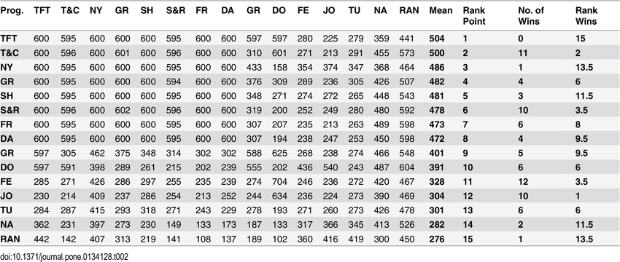
What do we already know?
Studies by Axelrod (1981) indicate that TFT is highly effective due to its simplicity, robustness, and
reciprocity. Subsequent research highlighted vulnerabilities of pure TFT, leading to variants like Generous
Tit-for-Tat and Suspicious Tit-for-Tat, incorporating elements of forgiveness and caution.
Is Tit-for-Tat the Answer? On the Conclusions Drawn from Axelrod's Tournaments - Scientific Figure on ResearchGate. Available from: https://www.researchgate.net/figure/Tournament-Scores-in-Axelrods-First-Tournament_fig2_281107220 [accessed 2 Jun 2025]

Slide 8
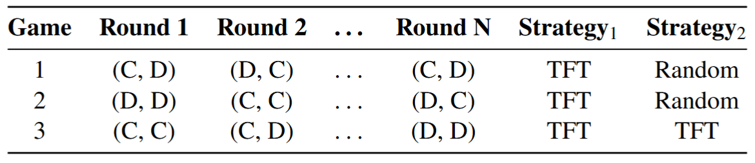
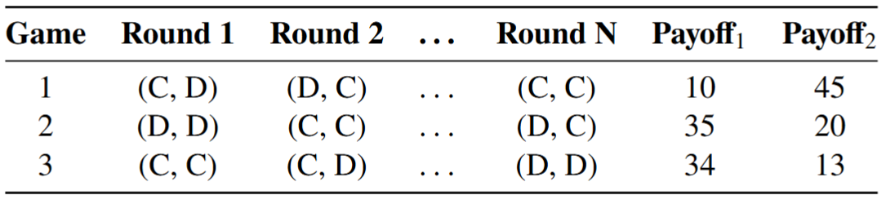
Dataset
60-20-20 Train Test Validation
Classification
Prediction

Slide 9
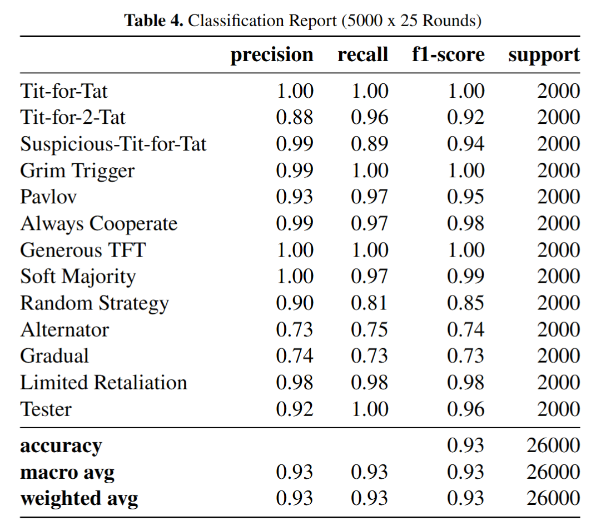
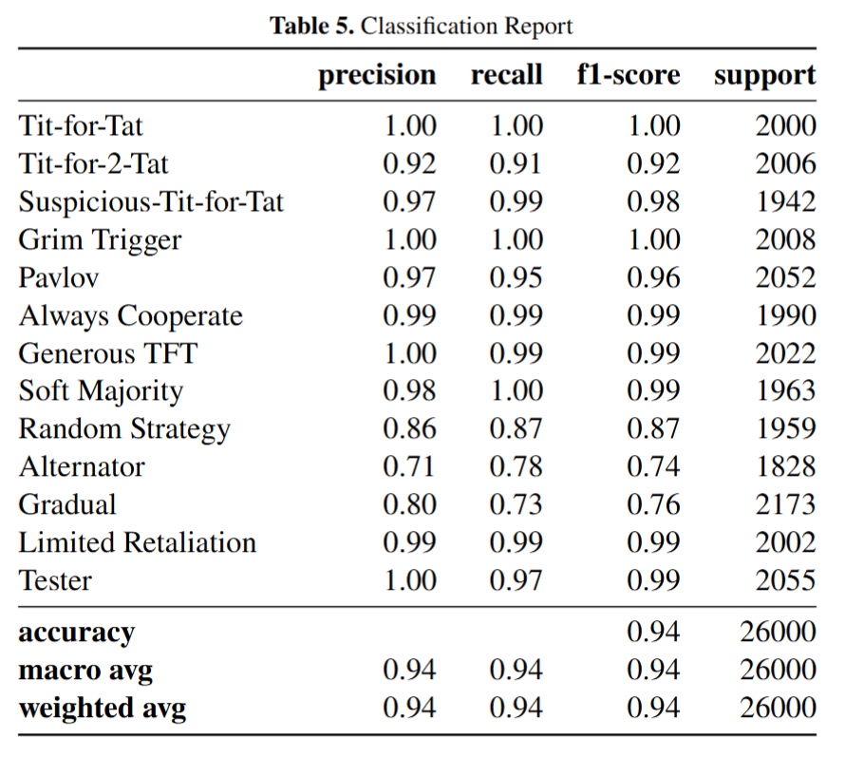
Classification Results
XGBoost
LSTM
Model tuned with GridSearchCV
Model tuned with KerasTuner

Slide 10
Classification Performance
Overall accuracy of greater than 93%
Near-perfect precision/recall for TFT, Grim Trigger, Generous TFT
Lower scores for Alternator, Gradual due to complex behaviors

Slide 11
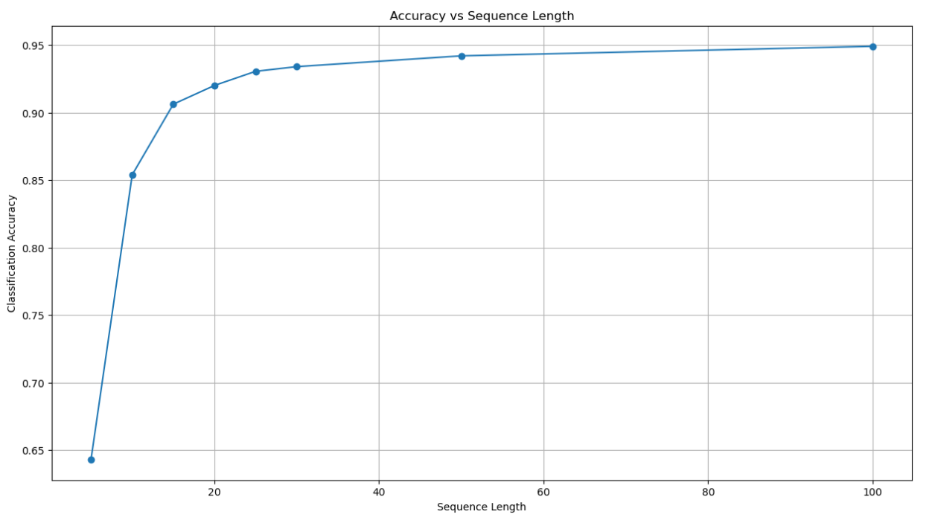
How many rounds do we need?
XGBoost - Accuracy as more rounds are played

Slide 12
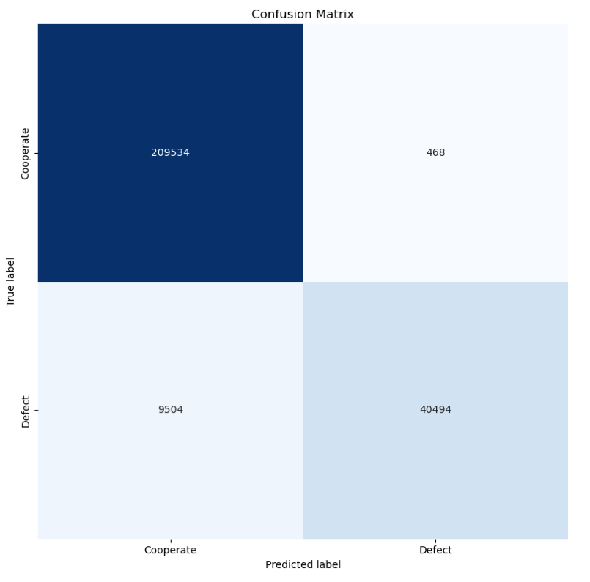
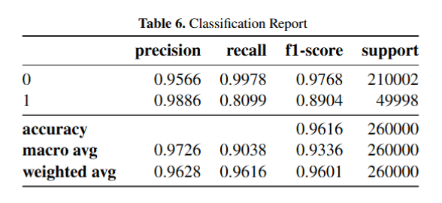
Prediction Results
XGBoost
0: Cooperate 1: Defect
Model tuned with GridSearchCV

Slide 13
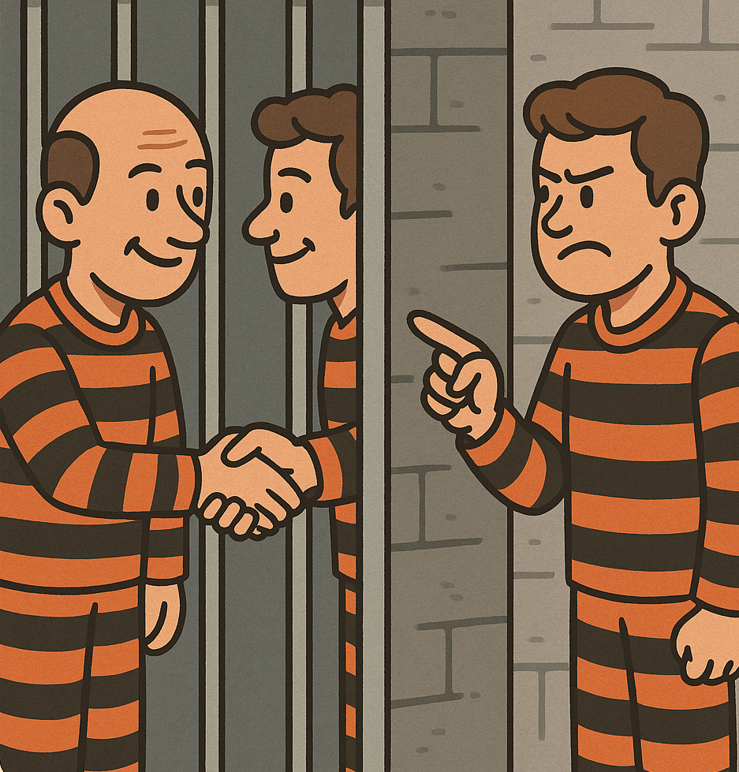
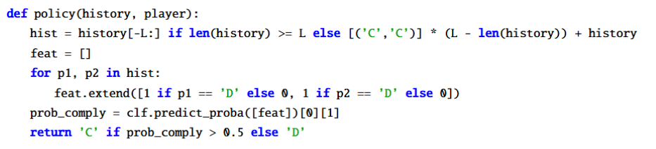
Exploiting Predictability
Winning by extremes will lead to resentment and disdain.
Can we build an ethical player that ensures a “win” without completely destroying the enemy?
By mimicking the opponents move, we level the playing field: ensuring both players receive the same payout. This strategy banks on the fact that we can gain an "advantage" in the starting stages of the game, when our model is not prepared to make predictions, by implementing a Tit for Tat or similar strategy. Once we have enough data to predict an opponents move, we can level out the playing field by mimicking.

Slide 14
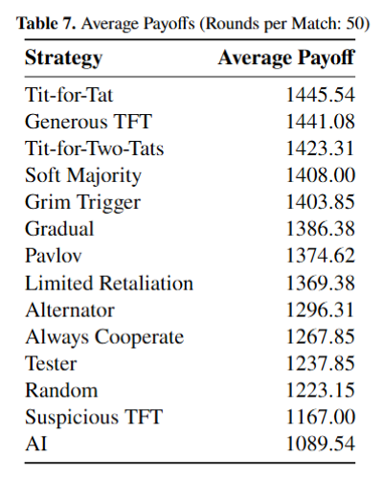
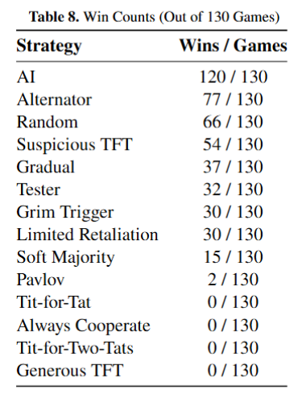
Tournament With An AI Player
10 games per distinct pair of strategies.
Games will have varying number of rounds to exhaust model performance. For each tournament, we will record number of “Wins” and “Average Payoff” to gauge model performance.

Slide 15
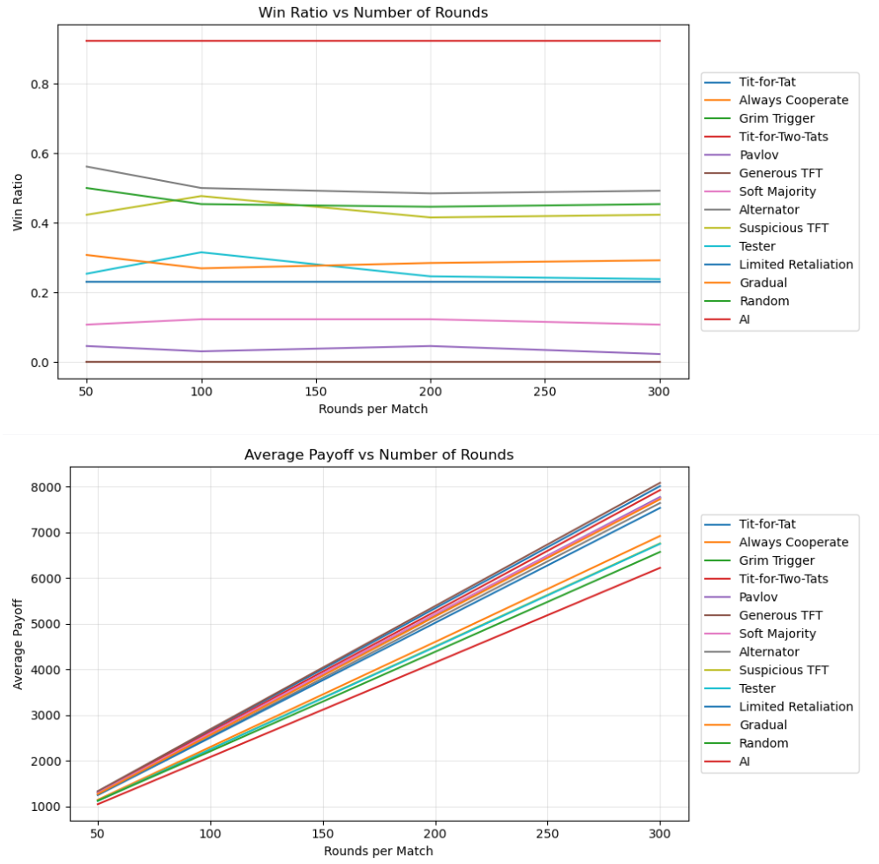
Results
AI player achieves the highest Win Rate with lowest average payoff across every number of rounds tested per game.
This showcases the possibility of applying Machine Learning to create ethical players with a system that can be model by the iterated prisoner’s dilemma.

Slide 16
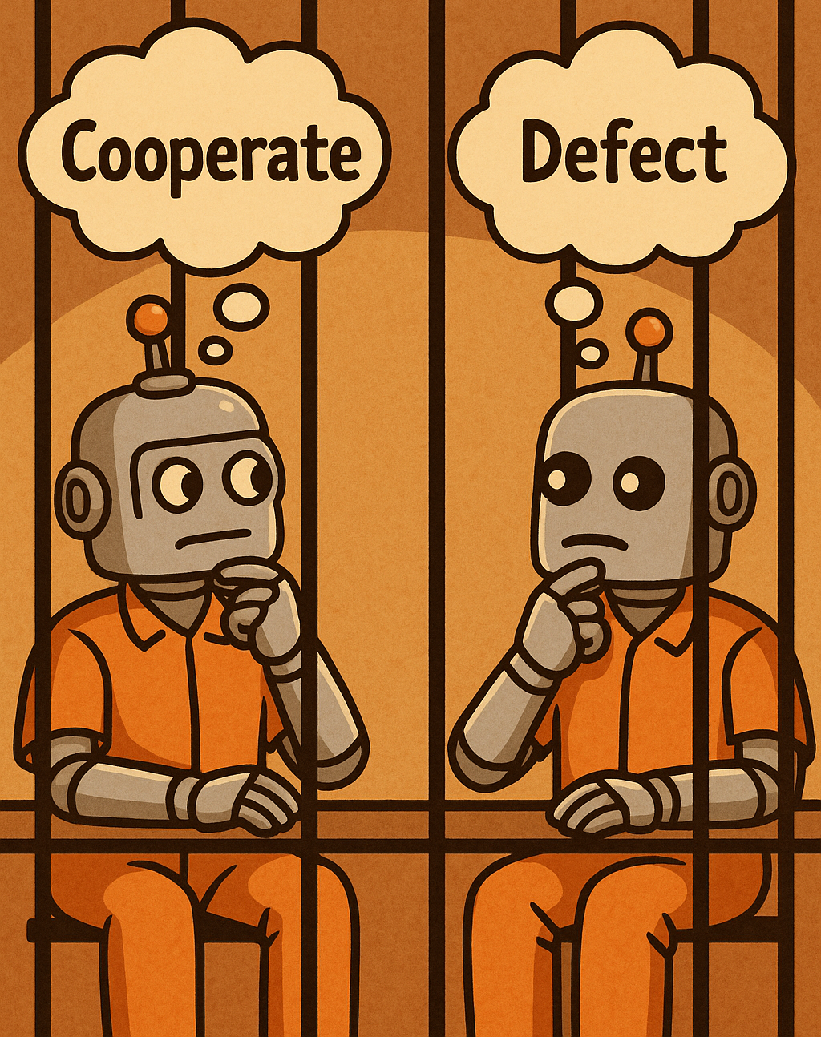
Conclusion
Conclusions
Classifier identifies strategy ideally after 25 rounds.
Predictive model achieves near perfect forecasting on opponent defections.
AI wins majority of matches while minimizing payoffs across varying round lengths per game.
Future Work
Incorporate noise to test robustness.
Simulate multi-agent ecosystems.
Analyze the effect of using different starting strategies.
Analyze how AI players play against each other

Slide 17
References
Axelrod, R. (1984). The Evolution of Cooperation. Basic Books.
Axelrod, R., & Hamilton, W. D. (1981). The evolution of cooperation. Science, 211(4489), 1390–1396.
Nowak, M. A., & Sigmund, K. (1993). A strategy of win-stay, lose-shift that outperforms tit-for-tat in the Prisoner’s Dilemma game. Nature, 364(6432), 56–58.

